Slide 1

KARIGARI(IT)

Slide 2
CCA(CERTIFICATION IN COMPUTER APPLICATION) A “FUTURE SKILL PROGRAM”

Slide 3

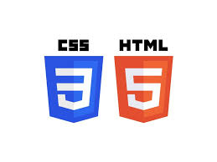
CURRICULUM HIGHLIGHTS
Fundamental Computer Concepts: Covers basic understanding of computers and their functions.
MS Word: Teaches document creation, formatting, and editing.
MS Excel: Covers data analysis, formulas, and spreadsheet management.
MS PowerPoint: Teaches attractive presentation creation skills.
Power BI: Guides students in creating dashboards for data visualization.
HTML and CSS: Introduces basic web design skills for website creation.

Slide 4
KEY IMPACT
Increased Employment Opportunities
Skill Development: Equips students with versatile skills in document creation, data analysis, web design, and visualization, meeting current industry demands.
Community Upliftment: By producing tech-savvy graduates, Karigari IT contributes to the digital advancement of the community.
Career Foundation: Acts as a stepping stone for students to explore further studies or specialized IT careers.

Slide 5
HANDS-ON LEARNING
Students receive extensive practice in real-world tasks, including document formatting, data management, and dashboard design.
Practical sessions in web design, data visualization, and software applications reinforce theoretical knowledge.
Allows students to work on individual projects to apply and consolidate their learning.

Slide 6
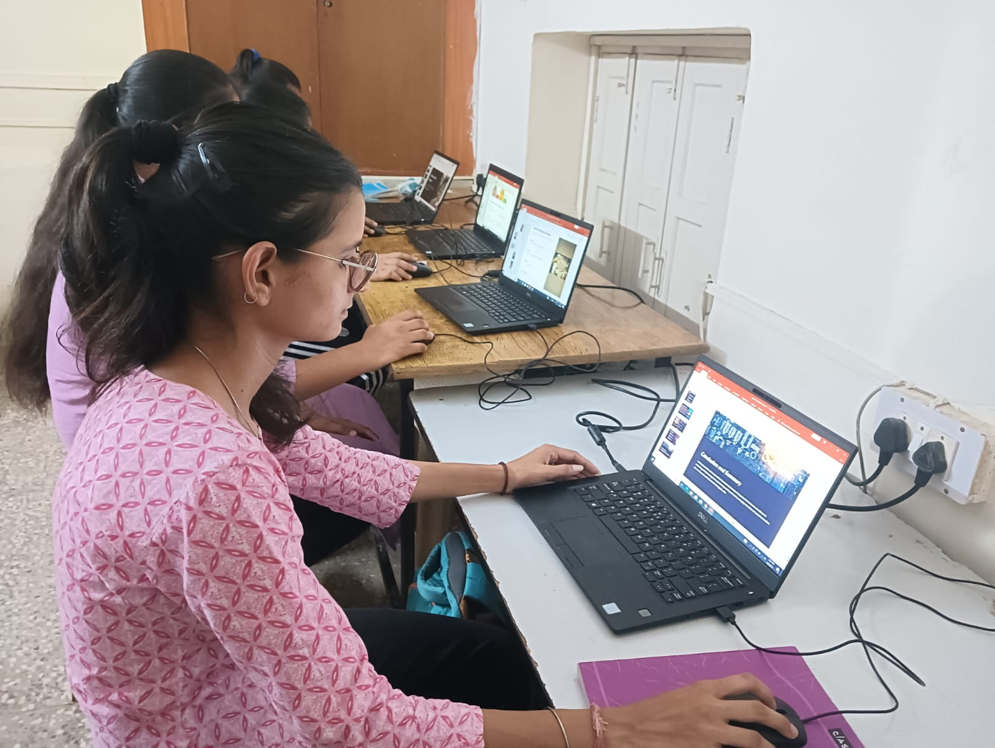
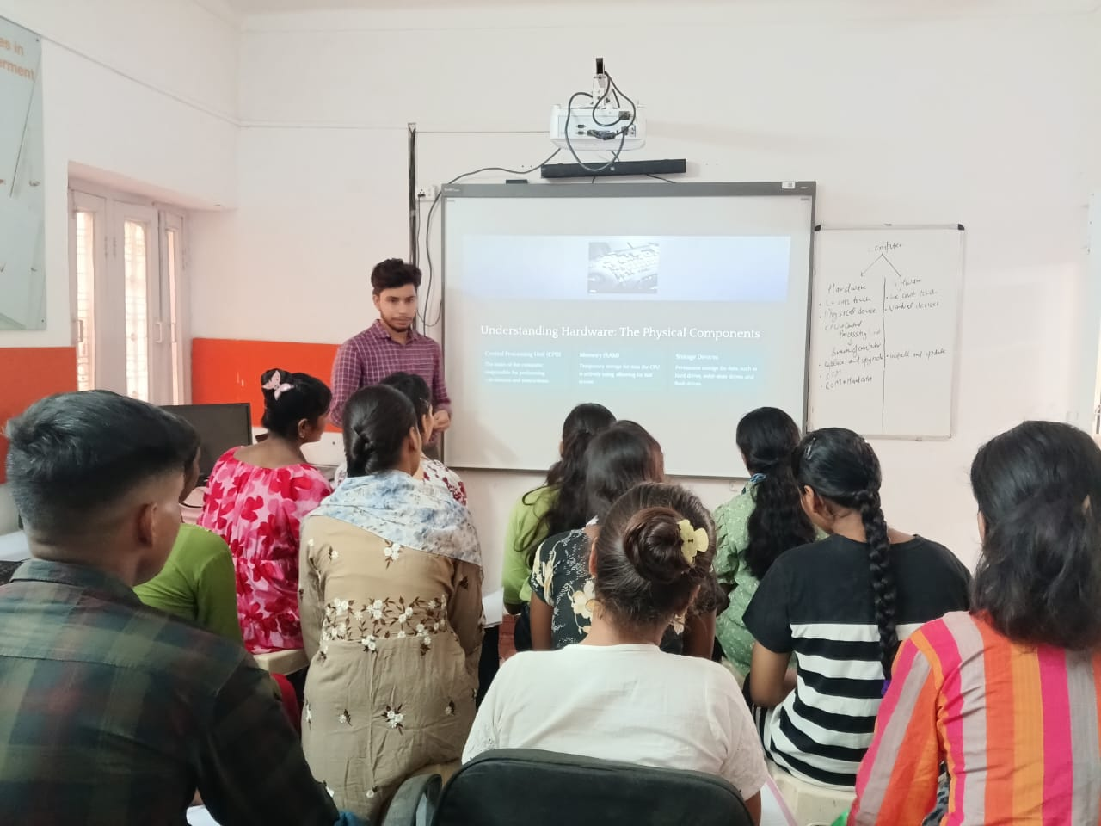
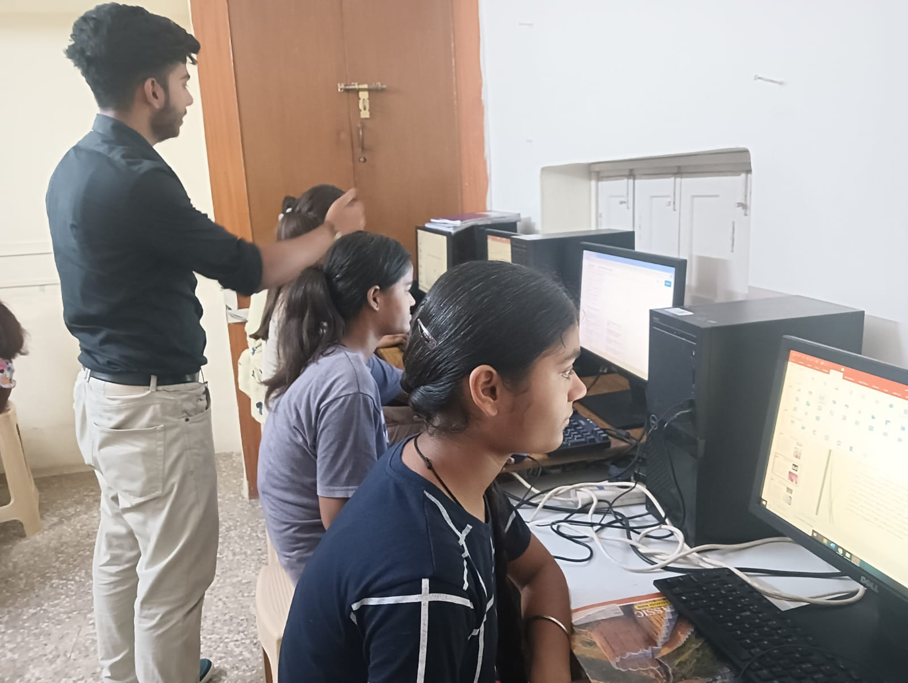
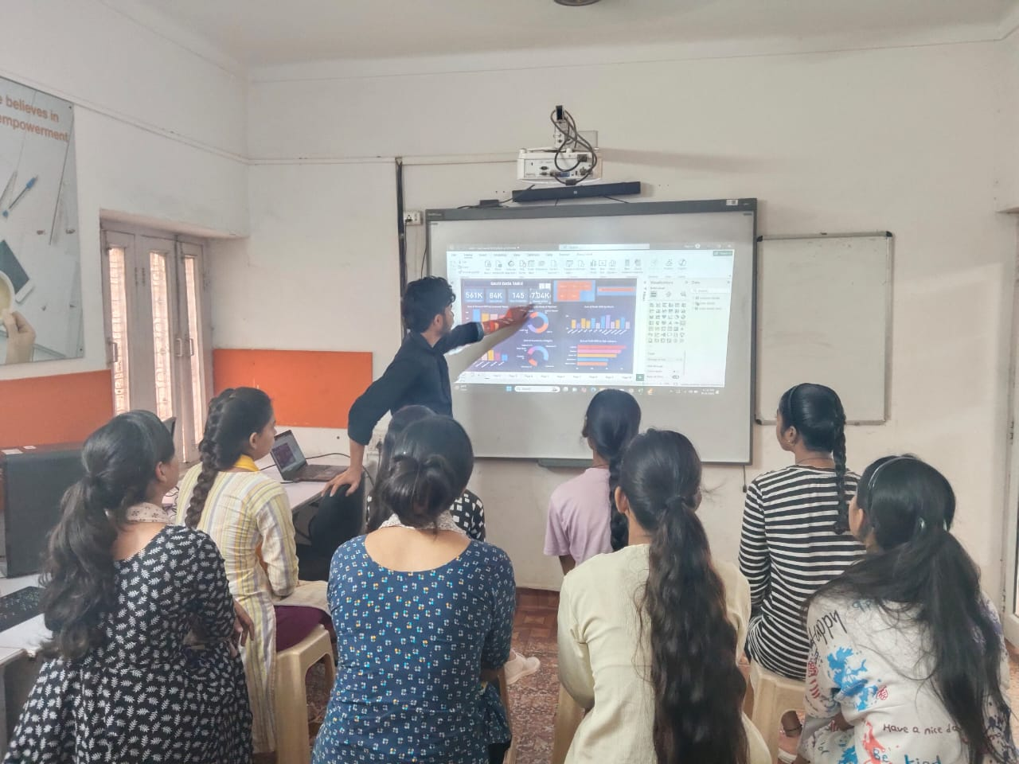
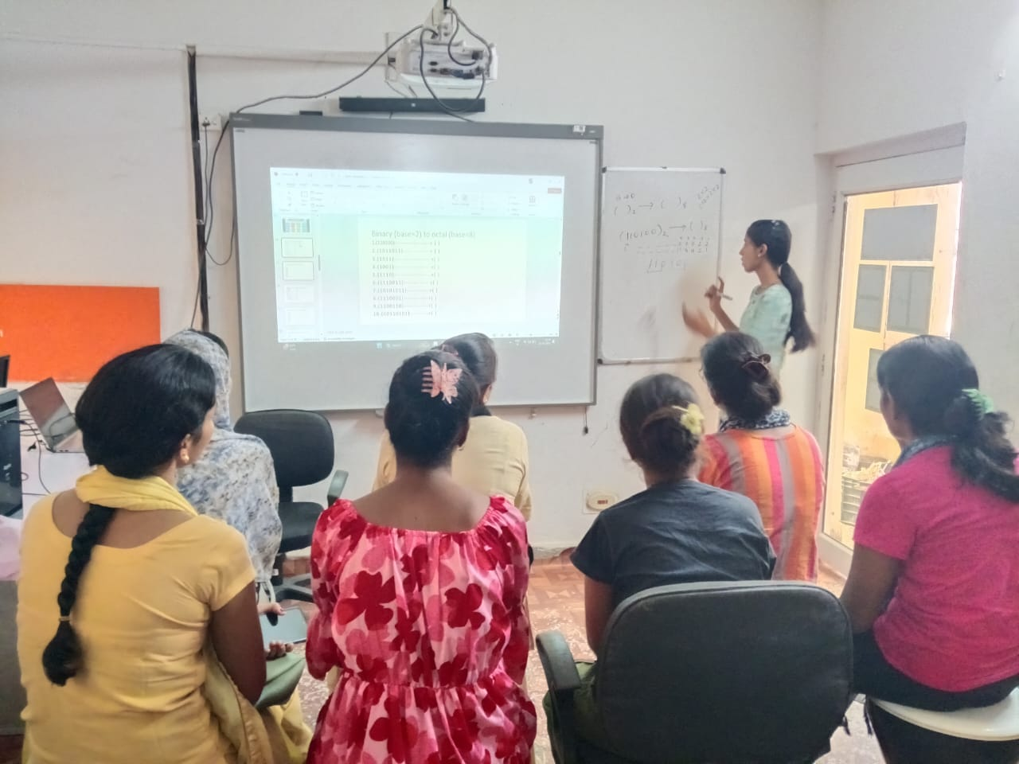
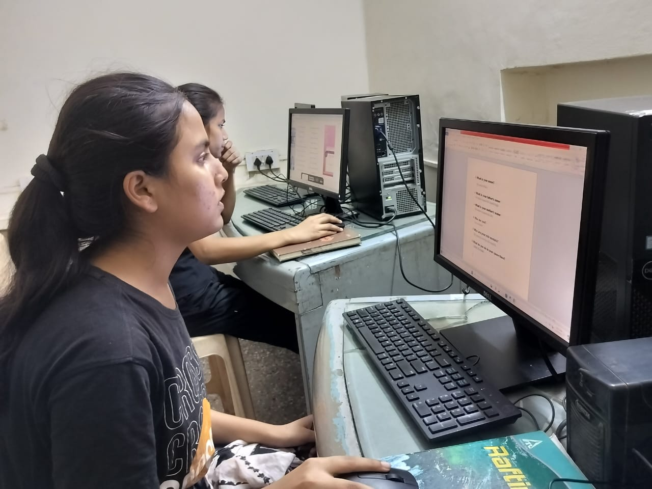
CLASSROOM PICTURES

Slide 7
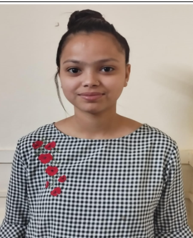
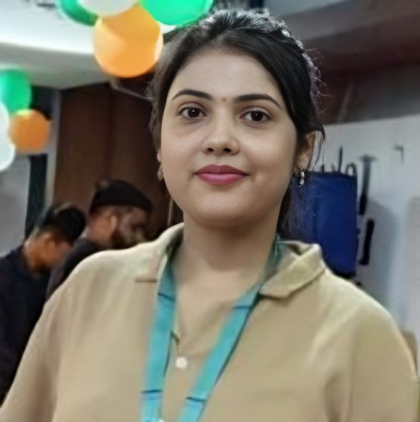
SUCCESS STORIES
Akansha, a dedicated student at Literacy India, completed her course in computer applications and secured a promising role in a well-established company. Her commitment to learning and applying new skills has empowered her to transition into the workforce, paving a successful career path with bright future prospects.
Priyanka, a graduate of the computer course at Literacy India, secured a job in a company, marking a significant achievement. Her dedication and hard work paid off, demonstrating the effectiveness of the skills she acquired. Priyanka’s success story serves as a motivating example for current students.

